Slide 1
CO2 Worldwide Emission
Group U3
Chenyue QIAN
Jiashan XU
Xinyu ZHOU

Slide 2
Table of contents
01
02
03
04
Background
Dashboard
Introduction
Display and Interaction
Insight
Limitation
Interesting Finding
Future improvements

Slide 3
Background
Purpose
Visualize global carbon emissions from 2002 to 2022 by continent, including comparisons with GDP, CO2 per capita, and population.
Target audience
Students, researchers, policymakers, and anyone interested in sustainable development
Vision
Develop an interactive data visualization tool for empowering action towards reducing carbon footprint and promoting sustainability for individuals and organizations

Slide 4
Data Resource
      Data on CO2 and
      Greenhouse Gas Emissions by
      Our World in Data with updated regularly
      analysis primarily focuses on two indicators, both based on the territorial emissions of carbon dioxide produced by a country
CO2_per_capita
the annual carbon dioxide emissions per person, enabling comparison of per capita emissions levels across different countries or regions
CO2
total carbon dioxide emissions in million tons and enables comparisons of emissions levels across different countries or regions, but does not consider population factors

Slide 5
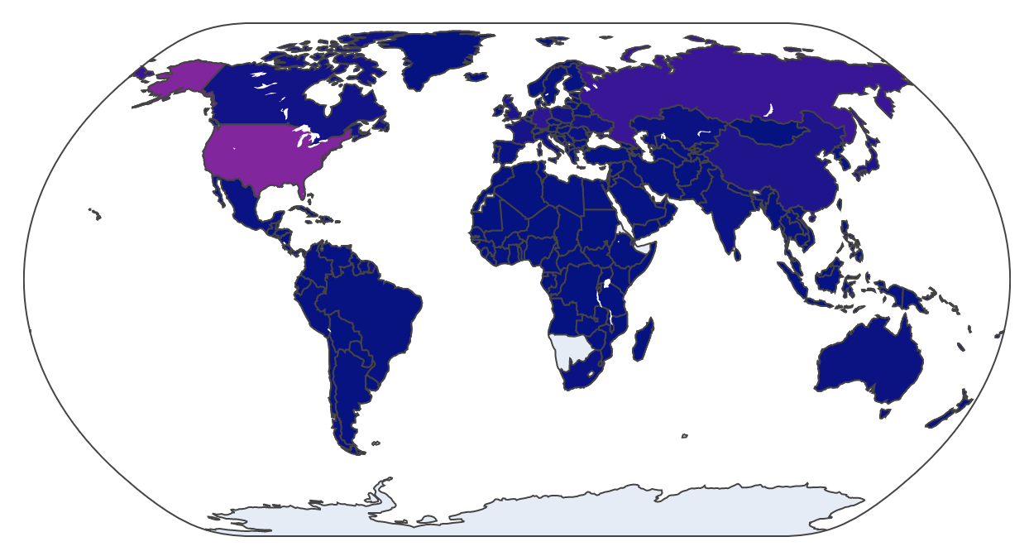
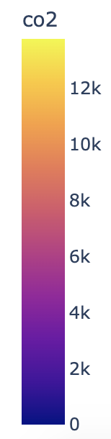
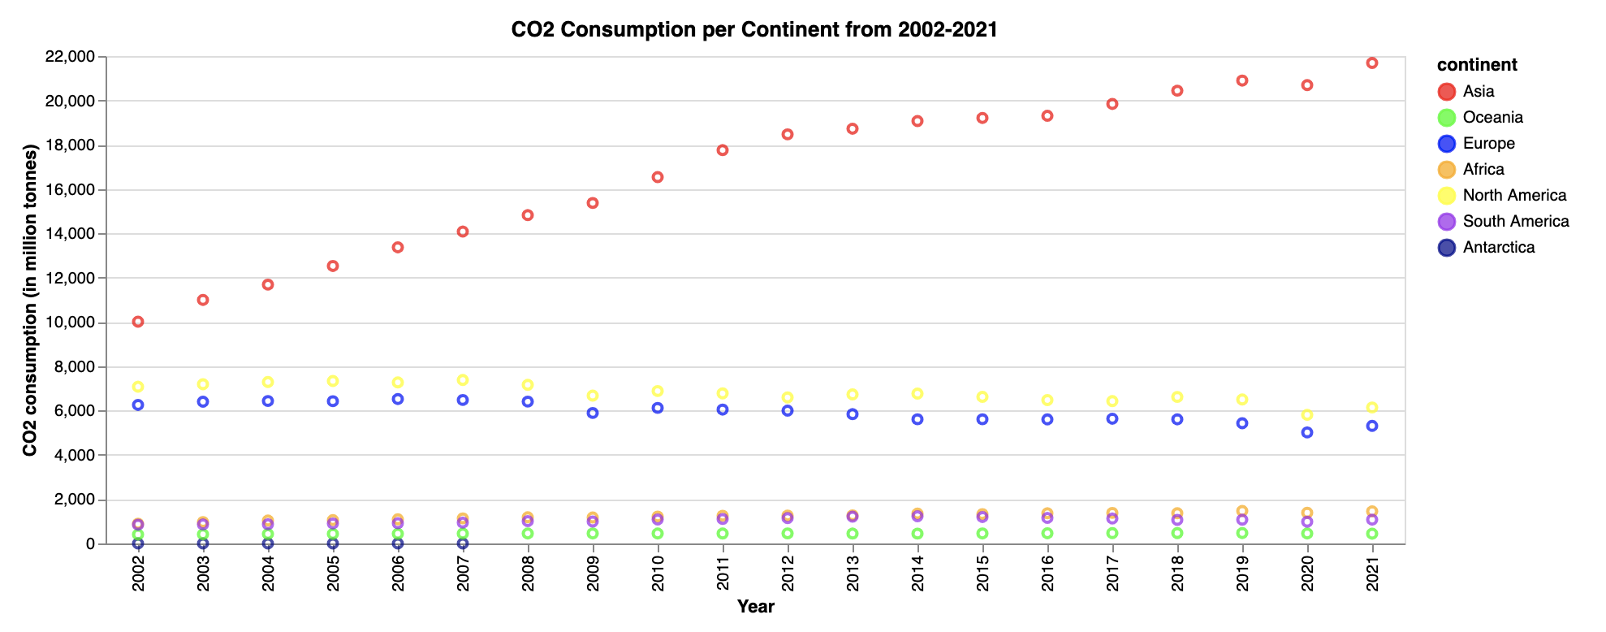
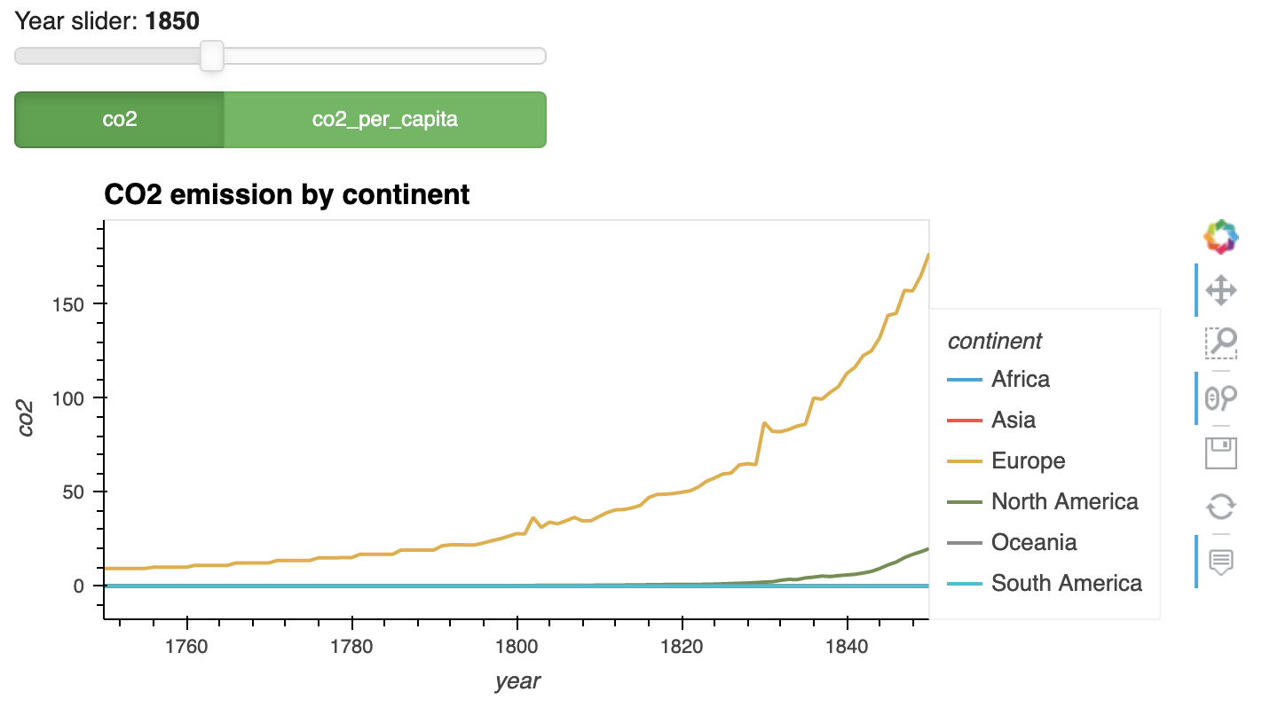
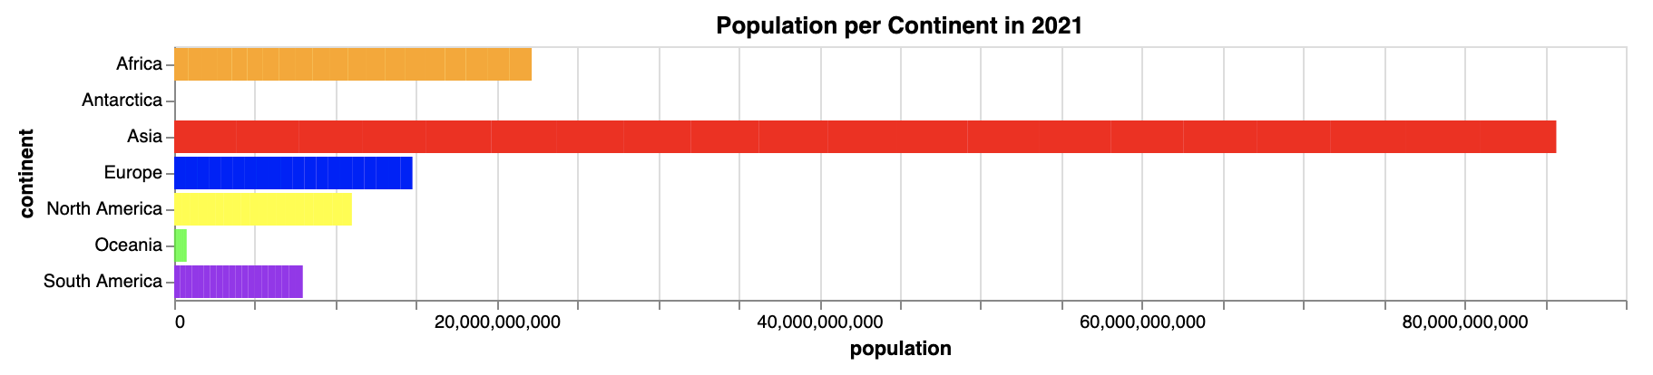
Dashboard

Slide 6
Interactive
Demo

Slide 7
Insight
China and the United States are the two largest emitter of CO2
CO2 emission in most continents is increasing with years except for Europe and North America
CO2 emission in Asia increased dramatically after 1950
CO2 emission of each region is highly correlated with its population. However, the causal relationship between regional population and CO2 emission is to be discussed.
Africa’s emission remains low despite its relatively high population level worldwide. Some deeper socio-economical reasons may be embedded.

Slide 8
Limitation
Enhance the tool's usefulness by exploring other types of CO2 emission indicators, such as those related to business, land use, and trade.
Use more different type of charts and interactive tools to extract insights from various dimensions, especially links between multiple views.
Associate data from more perspectives (eg: macro environments) in order to have potential exploratory insights

Slide 9
Thanks!

